Slide 1
5.3 Dynamic View(1)
Communication Diagram: registerNode
Security
PubKey : IoTMS’s public key. This key is used for sharing SessionKey.
SessionKey : made by SA-Node. This key is used for communicating between SA-Node and IoTMS.
1.2: registerNode(NodeId, ServerInfo, Serial)
:NodeManager
:Discover
1.5: onRegisterEvent
(Result, ThingList)
1.6: onRegisterEvent
(Result, ThingList)
1.3: Register(NodeId, ServerInfo, PubKey)
1.4: Registered
(E_{PubKey}(NodeId, SessionKey)
1.1: registerNode(NodeId, ServerInfo, Serial)
1.5: Authenticate
(E_{SessionKey}(NodeId, Serial))
1.6: Authenticated
(E_{SessionKey}(Result, ThingList))
:UI Controller
:SA-Node(Arduino)
1.7: updateRegister
(Result)
1: registerNode(NodeId, Serial)
1.6a: [Result=Autorized]
storeThings(ThingList)
:UI View
:DB
: Note
: Object
: Link
: Asynchronous
: Synchronous or Call
: Reply
registerNode(Serial)
Sa-Node verify for security whether serial input from user is the same with SA-Node’s.
Serial is input by User. User can recognize it from SA node’s physically label.

Slide 2
5.3 Dynamic View(2)
Communication Diagram: addNode
addNode is called by Discover when SA-node registered successfully.
Create
newly created instance
Iteration
Loop to create thing
addNode(NodeId, Link)
2: addNode(ThingList, Link)
2.1*: [i:=0…ThingsList.size()]
: createThing(Type, Id)
:NodeManager
:Node
:ThingFactory
2.2: create(Type, Id)
1: getThingList(NodeId)
Type is used for distinguishing Sensor and Actuator.
:Thing
:DB
Create
newly created instance
: Note
: Object
: Link
: Asynchronous
: Synchronous or Call
: Reply

Slide 3
5.3 Dynamic View(3)
Communication Diagram: controlThing
1.1a.1: send(nodeid
,thingid,type,value)
:NodeManager
:Link
Rule Manager
Check rule sets and decide denial of control
[Result=Success]
1.1a : doCommand(nodeid,thingid,type,value)
1.1a.2: send(nodeid
,thingid,type,value)
:RuleManager
[Result=Deny]
1.1b: deniyAction()
1.1: controlThing(nodeid,thingid
,type,value)
:SA-Node(Arduino)
:UI Controller
Sa-Node
control actuator
[Result=Deny]
1.1b.1: Result of denial
1: controlThing(nodeid,thingid
,type,value)
controlThing(selection,value)
: Note
: Object
: Link
: Asynchronous
: Synchronous or Call
: Reply
:UI View

Slide 4
5.3 Dynamic View(4)
Communication Diagram: updateSensorInfo
doCommand
Hereafter start with 1.1a in Communication Diagram of controlThing.
1.1b: [value = thing.prevValue]
No operation
1.1: UpdateThingInfo(nodeid
,thingid,type,value)
:NodeManager
:Link
1.1a:[value != thing.prevValue]
UpdateThing(NodeId
,ThingId,value)
1.1a:[value != thing.prevValue]
UpdateThing(NodeId
,ThingId,value)
1.1aa: [ruleMatched()=true]
doCommand(nodeid,thingid,type,value)
1: onData(NodeId
,ThingId,value)
:UI Controller
:SA-Node(Arduino)
:RuleManager
1.1ab: [ruleMatched()=false]
No operation
1: updatelThing(NodeId
,ThingId, value)
updateSensorInfo()
Rule Manager
Check rule sets and decide action-control
:UI View
: Note
: Object
: Link
: Asynchronous
: Synchronous or Call
: Reply

Slide 5
5.3 Dynamic View(5)
Communication Diagram: sensor mal-function
Rule Manager
Check rule sets and decide sensor mal-function
1.1b: [value = thing.prevValue]
No operation
1.1: UpdateThingInfo(nodeid
,thingid,type,value)
:RuleManager
:NodeManager
:Link
1.1a:[value != thing.prevValue]
UpdateThing(NodeId,ThingId,value)
1.1ab: [ruleMatched()=false]
No operation
1.1a:[value != thing.prevValue]
UpdateThing(NodeId,ThingId,value)
1.1aa: [ruleMatched()=true]
sendMessage(nodeid,thingid,type,value)
1: onData
(NodeId,ThingId,value)
:UI Controller
:Message
:SA-Node(Arduino)
sendMessage
Send mal-function message to predefined user.
1: updatelThing
(NodeId,ThingId, value)
updateSensorInfo()
:UI View
: Note
: Object
: Link
: Asynchronous
: Synchronous or Call
: Reply
Mal-function
Rule can handle sensor mal-function.
Condition : predefined senorsor’s upper/ lower boundary
Actions : notify user such as message (default),
* User may change both conditions and actions.

Slide 6
5.3 Dynamic View(6)
Communication Diagram: actuator mal-function
Rule Manager
Check rule sets and
do predefined actions. (Close door)
1.2: doCommand
(nodeid,thingid,type,value)
: close door
1.3: send
(nodeid,thingid,type,value)
: close door
[door == close]
2.2.a : set Alarm mode
:RuleManager
:NodeManager
:Link
2.2 UpdateThing
(NodeId,ThingId,value)
: Door sensor
2.1: UpdateThingInfo
(nodeid,thingid,type,value)
: Door sensor
1.1: setMode (alarm)
2: onData
(NodeId,ThingId,value)
: Door sensor
1.4: send
(nodeid,thingid,type,value)
: Close door
[door!=close]
2.2.b : sendMessage (nodeid,thingid,type,value)
:UI Controller
:Message
:SA-Node(Arduino)
updateSensorInfo()
Sa-Node
control actuator
1: setMode (alarm)
set mode (alarm)
: Note
: Object
: Link
: Asynchronous
: Synchronous or Call
: Reply
:UI View

Slide 7
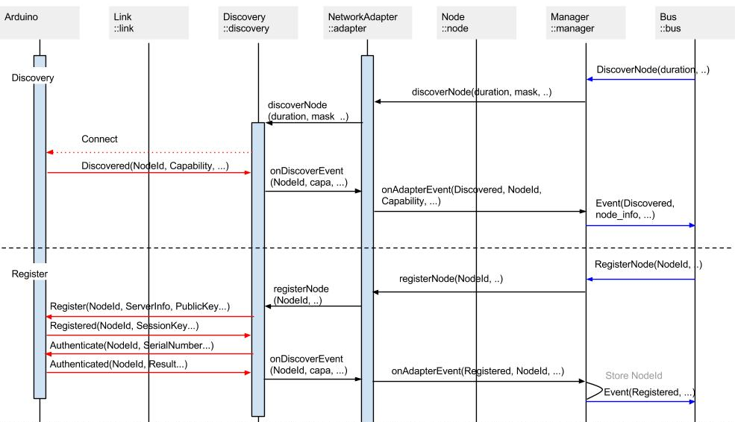
5.3 Dynamic View(7)
Sequence Diagram: discoverNode, registerNode

Slide 8
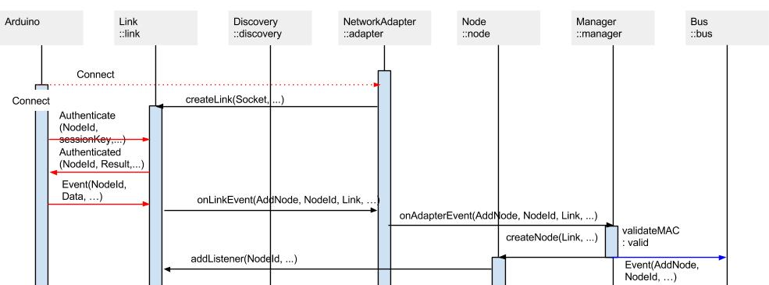
5.3 Dynamic View(8)
Sequence Diagram: Connect

